Slide 1



STAKEHOLDER MAP
HOW TO USE?
BOOTCAMP ONE | DAY TWO
HCD EXERCISE | FOUNDATION
UNDERSTAND THE PEOPLE INVOLVED
1
Target
Note down: The core target user/customer being designed for.
Objective of Exercise
To identify the target user/customer and understand people/organisations/ entities that form part of the ecosystem that influences the target user. To identify those who may be included in the research process.
Tool
Stakeholder Map
About ‘Stakeholder Map ’
The tool is used to develop an overarching understanding of the ecosystem of people, institutions, organisations, and any other entities who influence a user/customer. The concentric circles are used to visually depict the distance of influence (direct or indirect). The size of bubbles/circles representing a stakeholder can be used to depict the degree of influence.
2
Direct Influencers
Note down: Those who have the most immediate influence on the target user/customer.
Target
3
Indirect Influencers
Note down: Those
who are not directly connected to the user but have important influence.
Direct
Influencers
Indirect
Influencers
4
Other
Stakeholders
Other Stakeholders
Note down: Any other stakeholder who might have some influence on target user.
FINANCIAL INNOVATION LAB | BOOTCAMP ONE

Slide 2
BOOTCAMP ONE | DAY TWO
HCD EXERCISE | FOUNDATION
UNDERSTAND THE PEOPLE INVOLVED
Notes
Session Flow
Sharing the Objective | 2 Min
Facilitators to share the objective of the session/exercise.
Walkthrough - Example | 5 Min
Facilitators to walk through 1-2 examples of the tool in use.
Walkthrough - ‘How To?’ | 5 Min
Facilitators to walk through the ‘How to?’ of the tool as per instructions on the toolsheet.
Clarifications | 3 Min
Facilitators to clarify doubts from participants.
Exercise | 30 Min
Participants to use tool with guidance from the facilitation team. A potential flow of the exercise could be -
Team to discuss and agree on exercise - 5 Min
Individual members to note down stakeholders - 5 Min
Mapping stakeholders and discussion - 20 Min
Points to Consider
The numbering provided in the How To? is a recommended path. Startups may still choose to fill the template as per their convenience.
The influencers can be individuals or organisations.
Since the tool is used early in the design process, it is entirely possible that those on the map are just who we assume have influence - what is the exact nature of influence can be understood over time.
Influencers could be those the target user/customer is aware of or not.
The list of influencers should first be exhaustive. The list can be shortened based on research and discussion.
Influencers or stakeholders mapped are those that one must consider including in the research. Practical compulsions may demand that some influencers are prioritised over others.
The tool can be used again at the end of research to map the actual ecosystem.
Tool
Stakeholder Map
Material
Template, Chart Paper, Post-Its, Pens/ Sketch Pens
Time
45 Minutes
FINANCIAL INNOVATION LAB | BOOTCAMP ONE

Slide 3
TOOL: STAKEHOLDER MAP
Target
Direct
Influencers
Indirect
Influencers
Other
Stakeholders
FINANCIAL INNOVATION LAB | BOOTCAMP ONE

Slide 4
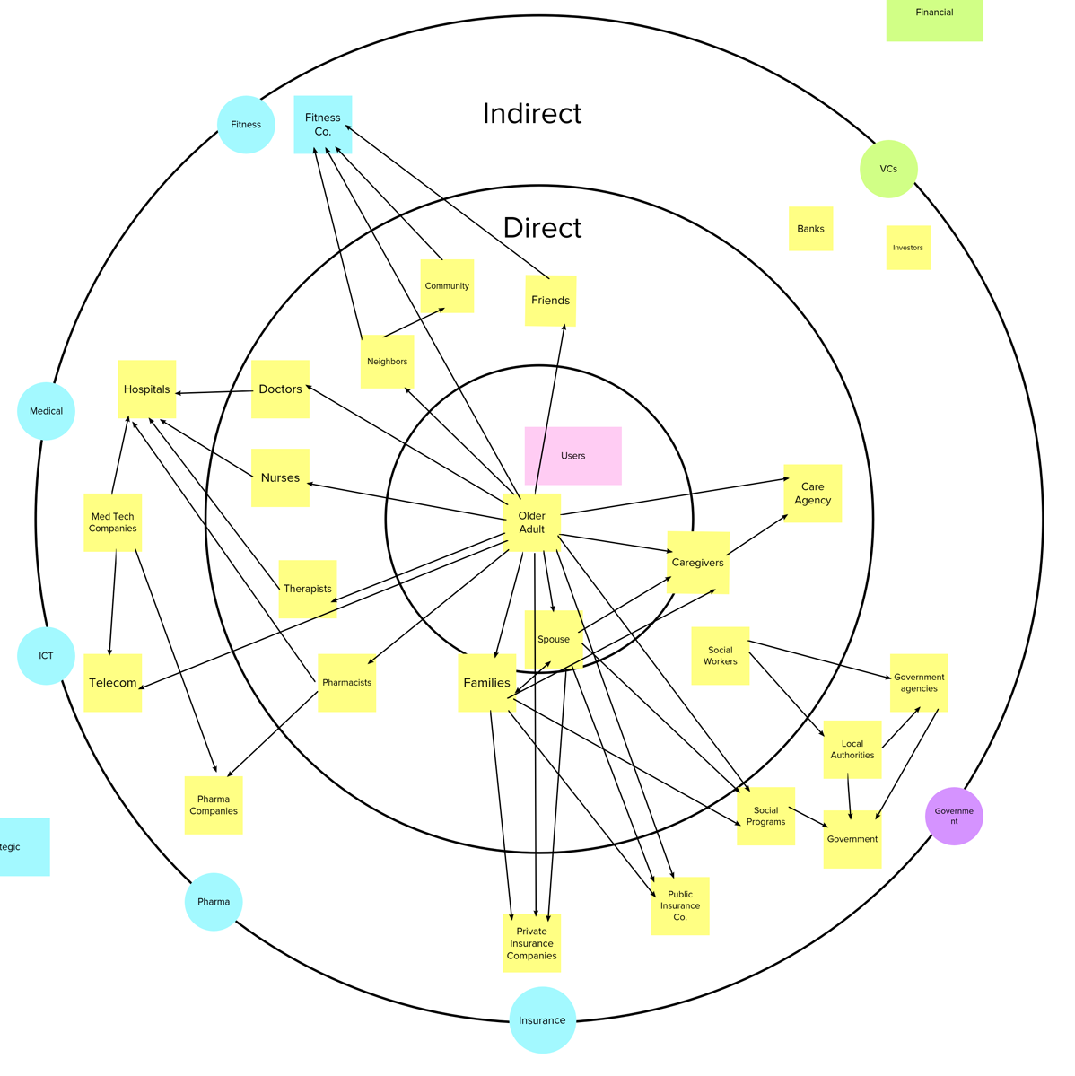
TOOL: STAKEHOLDER MAP
FINANCIAL INNOVATION LAB | BOOTCAMP ONE

Slide 5
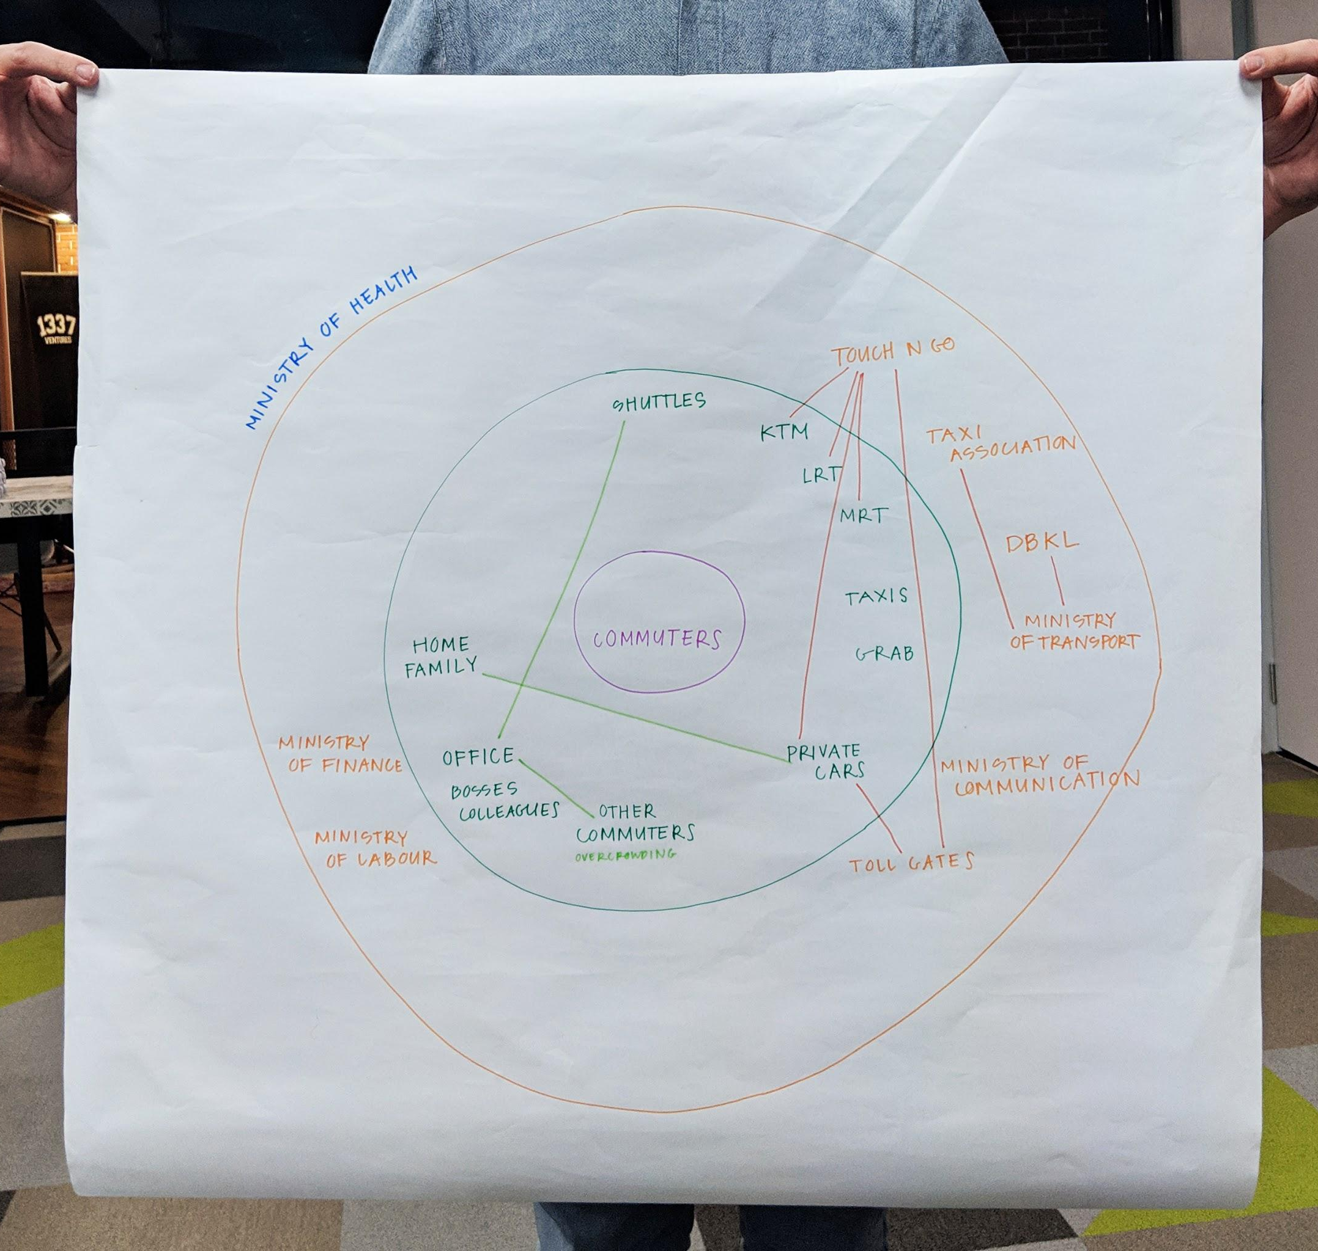
TOOL: STAKEHOLDER MAP
FINANCIAL INNOVATION LAB | BOOTCAMP ONE

